Slide 1
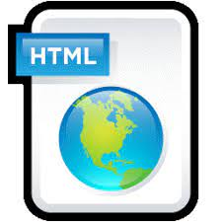
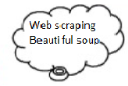
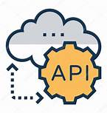



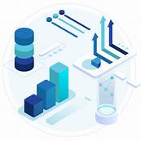
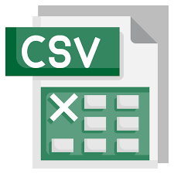
Data mining models
HDFS & MongoDB

Slide 2
Start
Scraping data from web
Load semi structured data in MongoDb
Cleaning and Transformation
End
Visualization
Fetching and loading data into Azure SQL
Kmeans Model Building

